Slide 1

DATA 620 Week 5 Part 2
Team 6
Alice Friedman, Stephen Jones, Jeffrey Littlejohn, Jun Pan

Slide 2
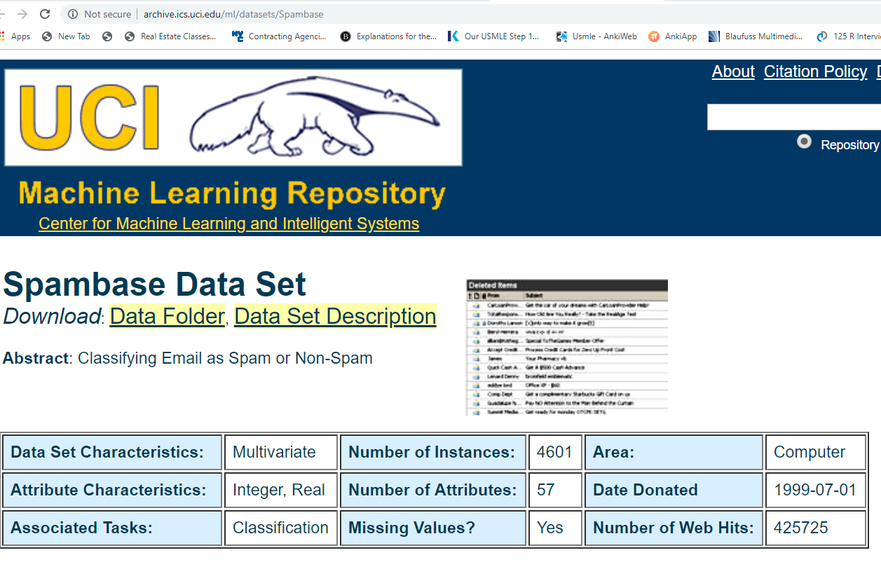
Dataset: Spambase, UCI http://archive.ics.uci.edu/ml/datasets/Spambase
To explore Spambase Dataset from the UCI Machine Learning Repository . We will build “decision tree”, “random forest”, “adaptive boosting” and “support vector machine”. And to see which one is more accurate. To compare the four models, confusion matrix will be built and misclassied email will be evaluated.

Slide 3
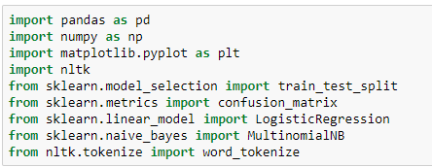
Setup Working Environment

Slide 4
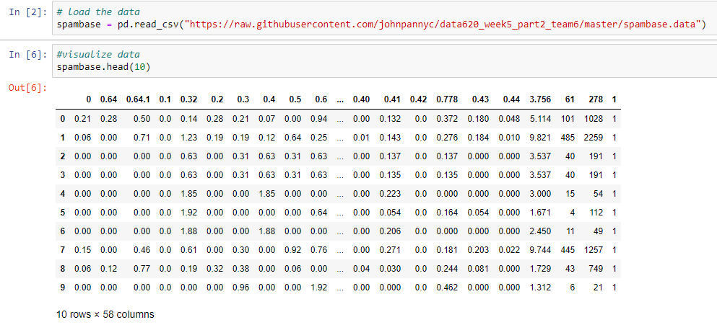
Load Data

Slide 5
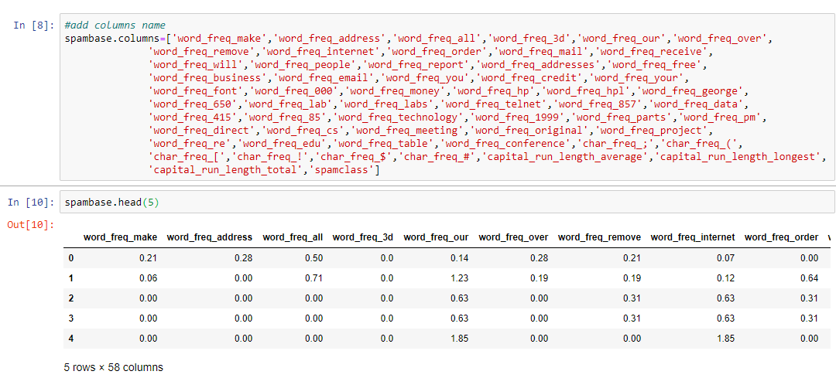
Add Column Names

Slide 6
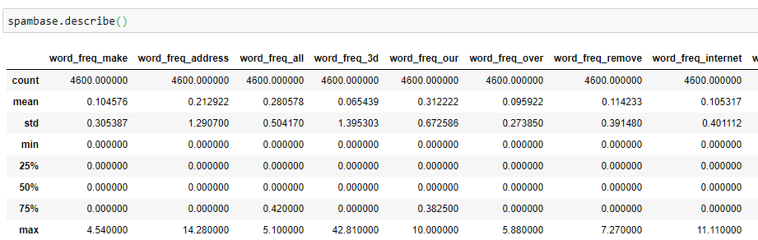
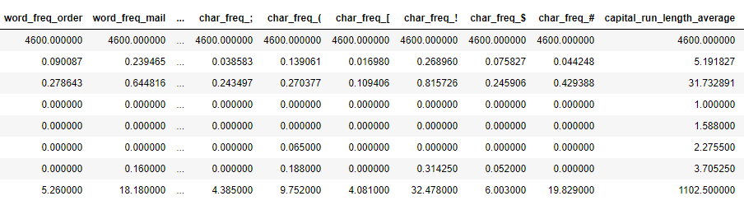
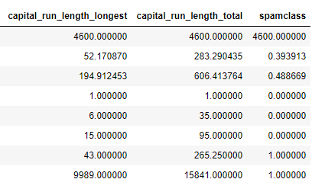
Overview data

Slide 7
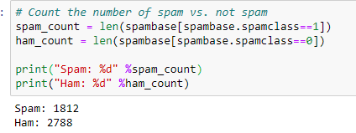
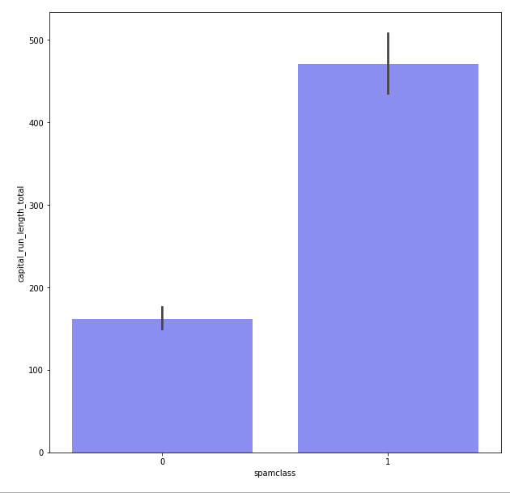
More Hams than Spams

Slide 8
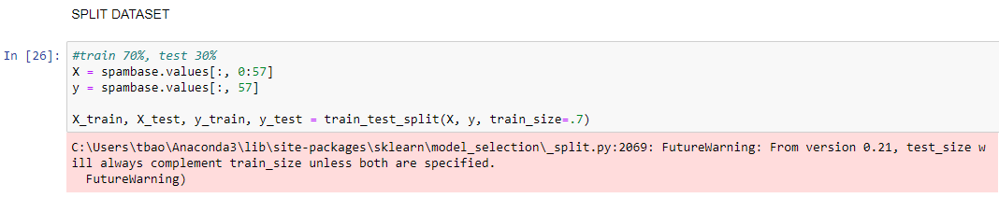
Split Data

Slide 9
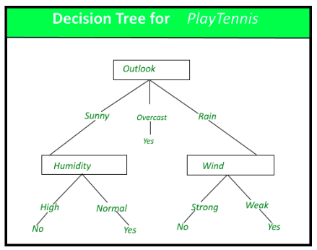
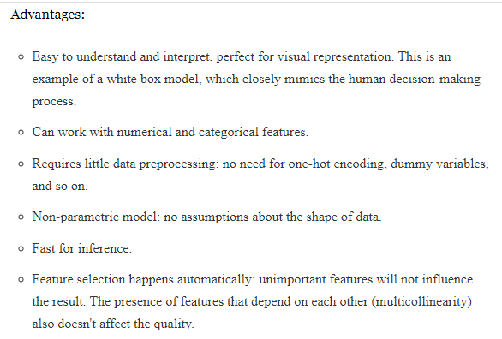

Decision Tree
A decision tree is a decision support tool that uses a tree-like graph or model of decisions and their possible consequences, including chance event outcomes, resource costs, and utility. It is one way to display an algorithm that only contains conditional control statements.

Slide 10
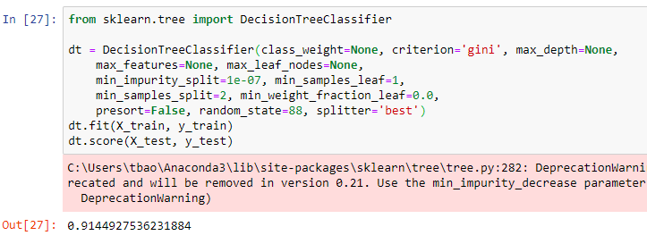
Accuracy

Slide 11
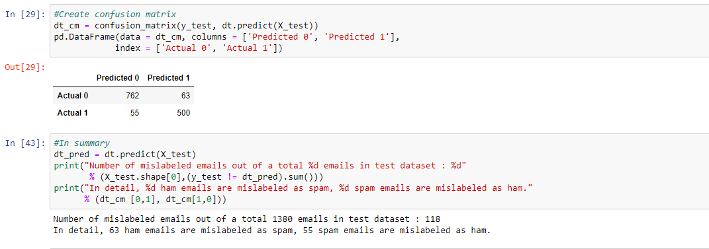
Confusion Matrix

Slide 12
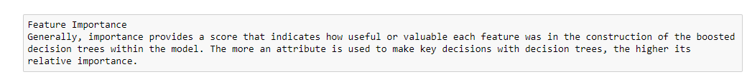
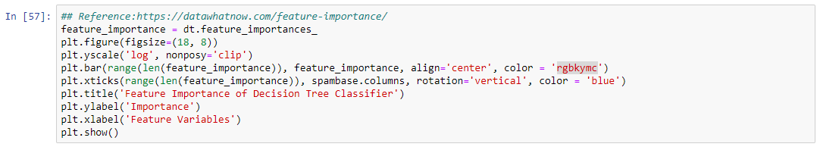
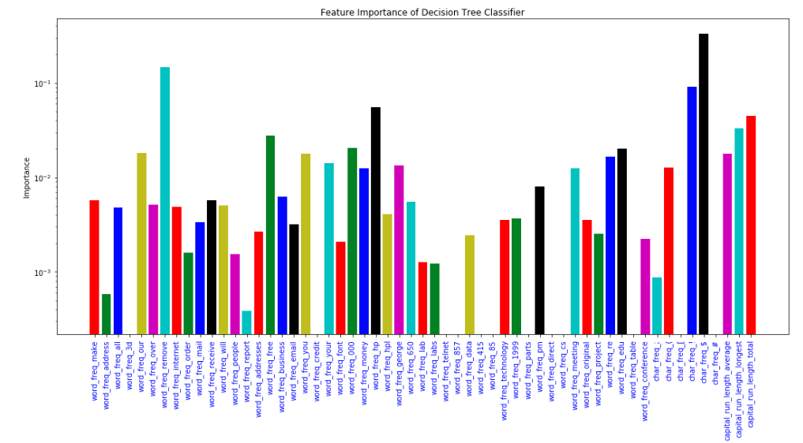
Feature Importance

Slide 13
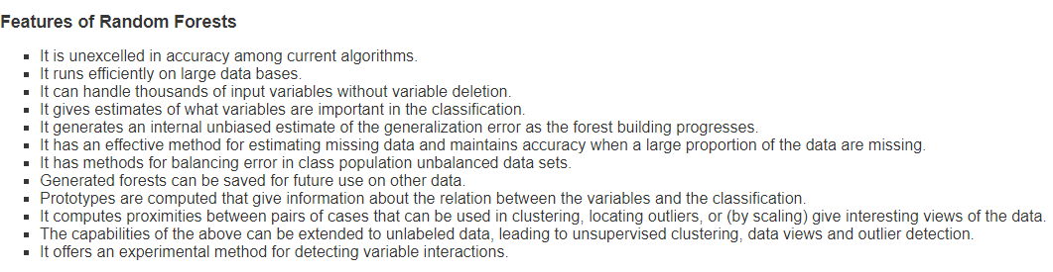

Random Forest

Slide 14
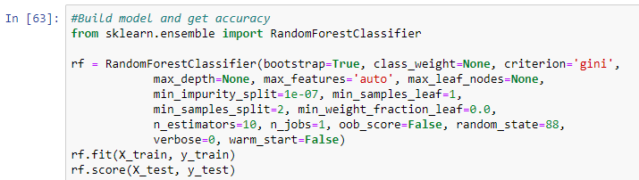

Build Random Forest Model

Slide 15
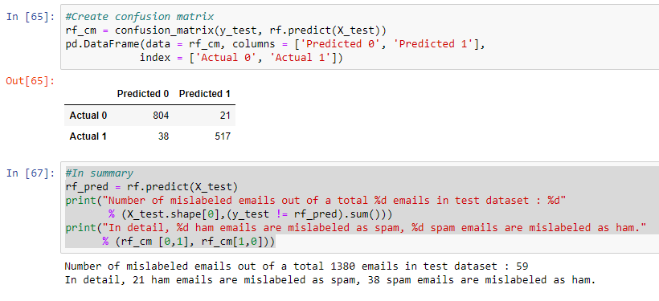
Confusion Matrix of Random Forest

Slide 16
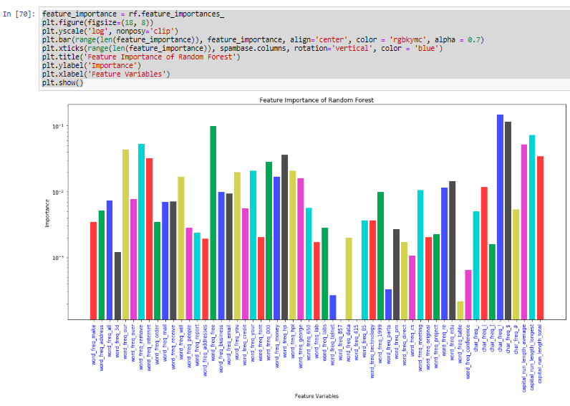
Feature Importance of Random Forest

Slide 17
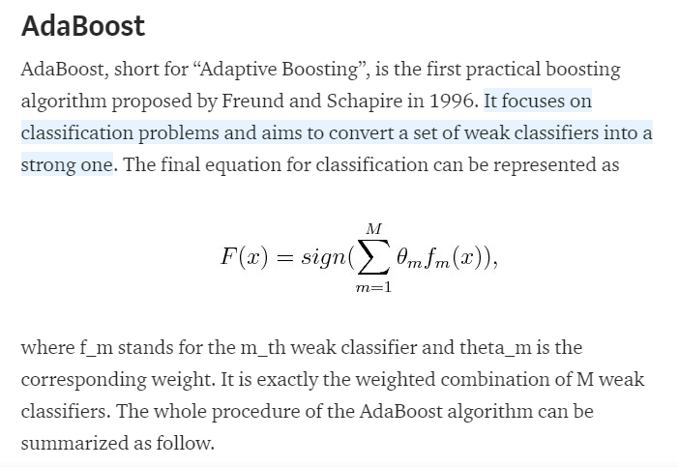
Adaptive Boosting

Slide 18
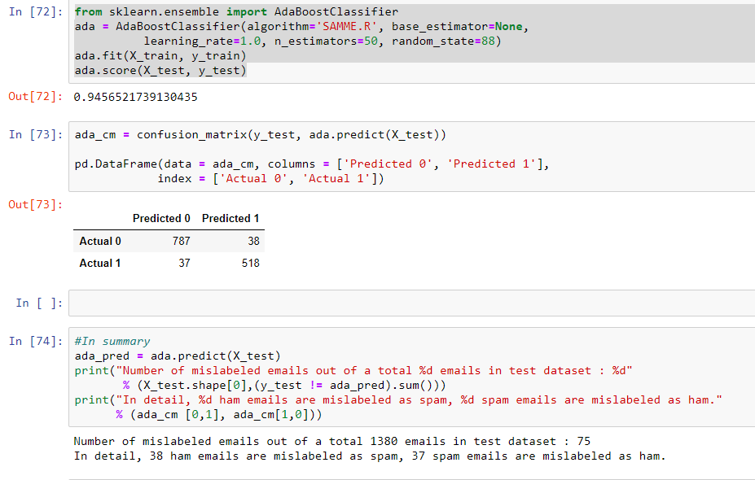
Build AdaBoost Model

Slide 19
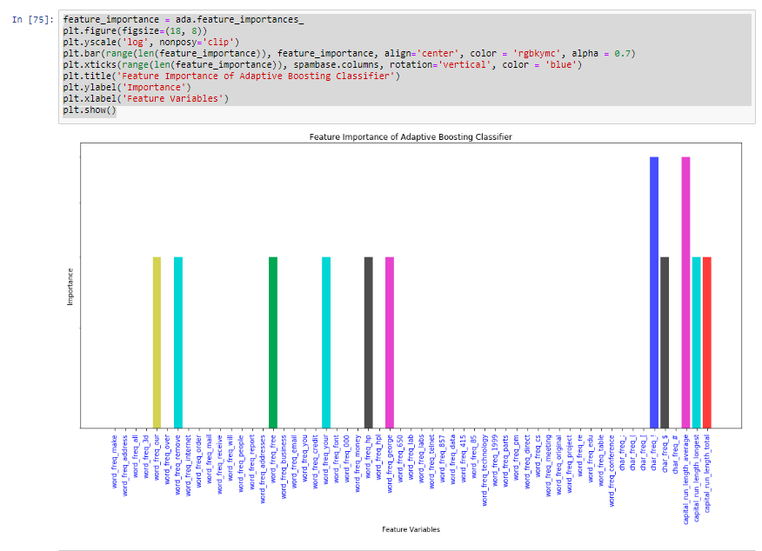
Feature Importance of AdaBoost

Slide 20
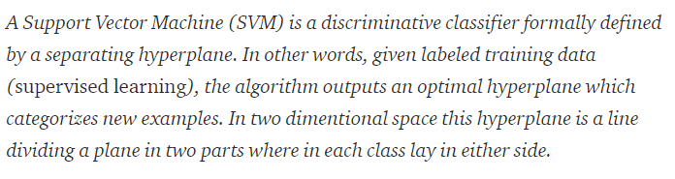
Support Vector Machine

Slide 21
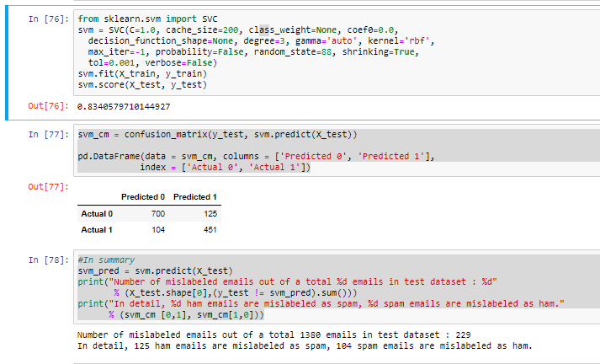
Build Support Vector Machine Model

Slide 22
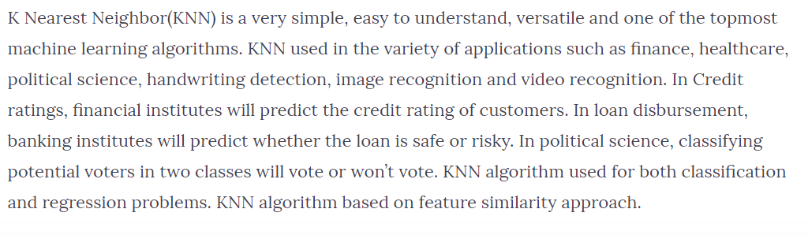
KNN

Slide 23
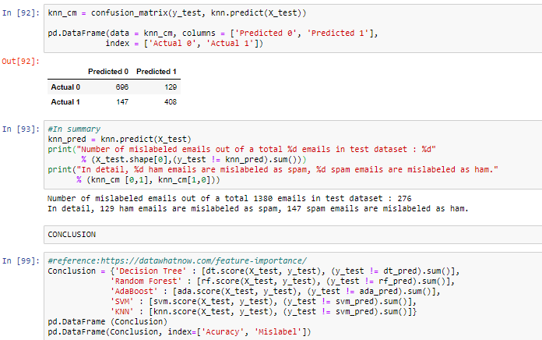
KNN Model

Slide 24
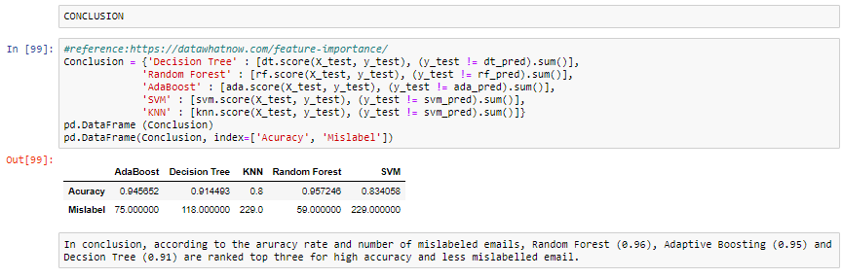
Compare Accuracy and Mislabel

